Slide 1




Practice
Constructing Online Interaction Graph
Digital Business Ecosystem Research Center

Slide 2
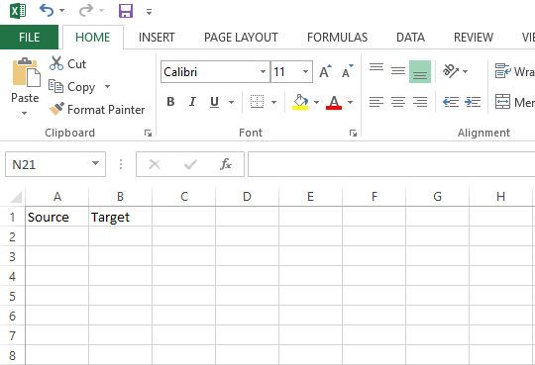

Construct the Dataset

Slide 3
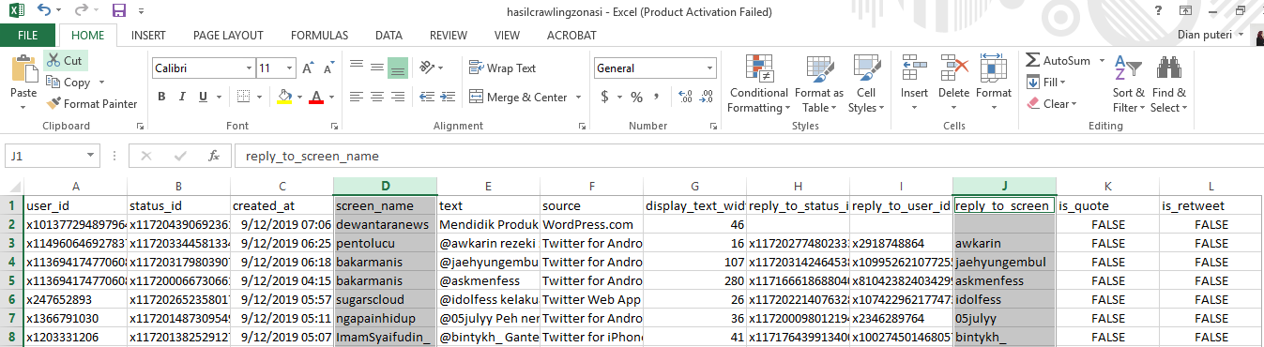
Construct the Dataset (2)
Source
Target

Slide 4
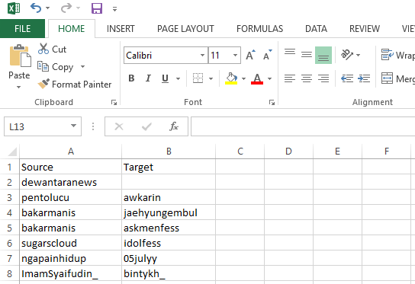
Construct the Dataset (3)

Slide 5
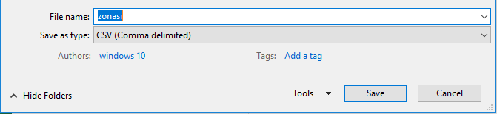
Construct the Dataset (4)
Save file as CSV

Slide 6
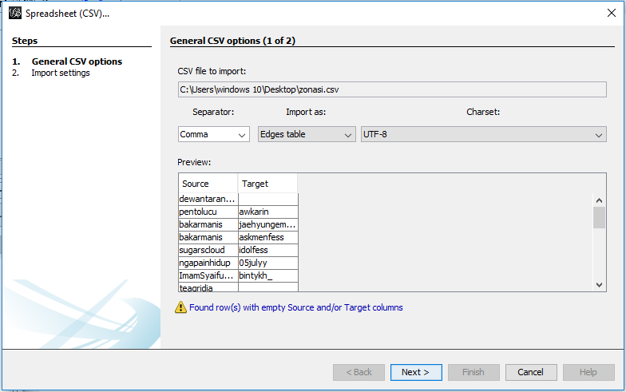
Import Dataset to Gephi
File > Import Speadsheet > Choose the Dataset File

Slide 7
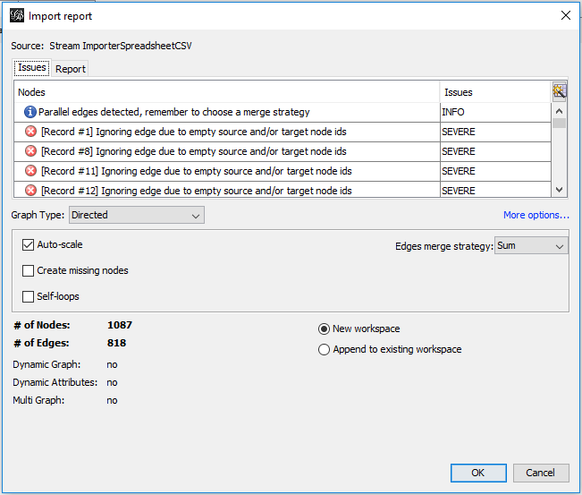
Data Information
Graph type can be undirected, directed, mixed
The workplace can be new or append to the existing one

Slide 8
Data Information
Graph type can be undirected, directed, mixed
The workplace can be new or append to the existing one

Slide 9
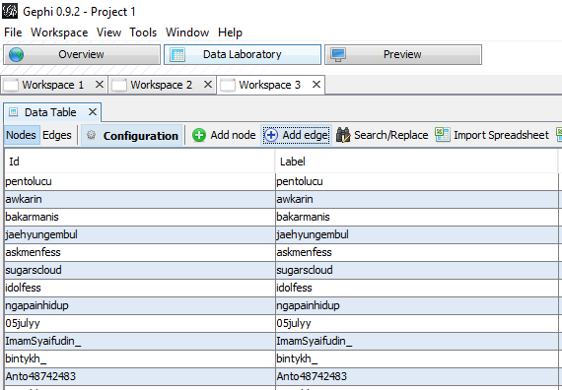
Define the Node Label
Click Data Laboratory
Choose Nodes
Click Copy Data to Other Column
Choose Id
Choose Label

Slide 10
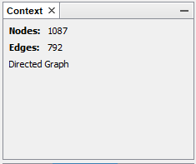
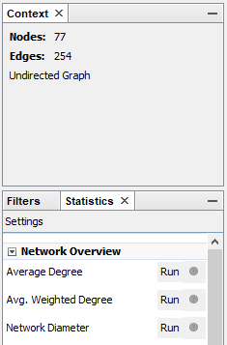

Run the Centrality Metric
Average Degree to measure Degree Centrality
Average Weighted Degree to measure Average Weighted Degree Centrality
Network Diameter to measure Betweenness Centrality and Degree Centrality
Eigenvector Centrality to measure Eigenvector Centrality

Slide 11
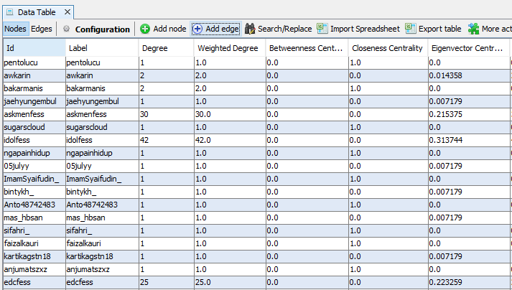
Centrality Metric Measurement Result

Slide 12
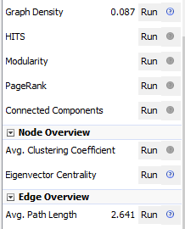
Run the Network Structure Metric
Graph Density to measure Network Density
Modularity to measure Community Detection
Connected components to measure Connected Components
Avg. Path Length to measure Average Path Length

Slide 13
Visualizing the Network Based on Centrality
Node Color Based on Centrality
Click Appearance > Nodes > Color > Ranking > Choose the Centrality > Apply
Node Size Based on Centrality
Click Appearance > Nodes > Size > Ranking > Choose the Centrality > Define the size > Apply
Edge Color Based on Weight
Click Appearance > Edges > Color > Ranking > Choose Weight > Apply

Slide 14
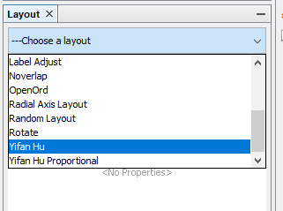
Network Layout
Click Layout > Choose Layout > Apply

Slide 15
Visualizing the Network Based on Community
Node Color Based on Community
Click Appearance > Nodes > Color > Partition > Choose the Modularity Class > Apply

Slide 16

THANK YOU

